Slide 1


Insurance Claims Processing
Hash Hustlers

Slide 2
Team Details
Team Head : Krit Lunkad
Email : krit24110267@snuchennai.edu.in
Phone : 9043044776
University / College : Shiv Nadar University Chennai
Member 1 : Anshukman MJ
Email : anshukman24110341@snuchennai.edu.in
Phone : 6380889875
University / College : Shiv Nadar University Chennai
Member 2 : Aravind Kumar S
Email : aravindkumar24110463@snuchennai.edu.in
Phone : 7539962693
University / College : Shiv Nadar University Chennai
Member 3 : Dheeran Sankaran
Email : dheeran24110056@snuchennai.edu.in
Phone : 6383766338
University / College : Shiv Nadar University Chennai

Slide 3
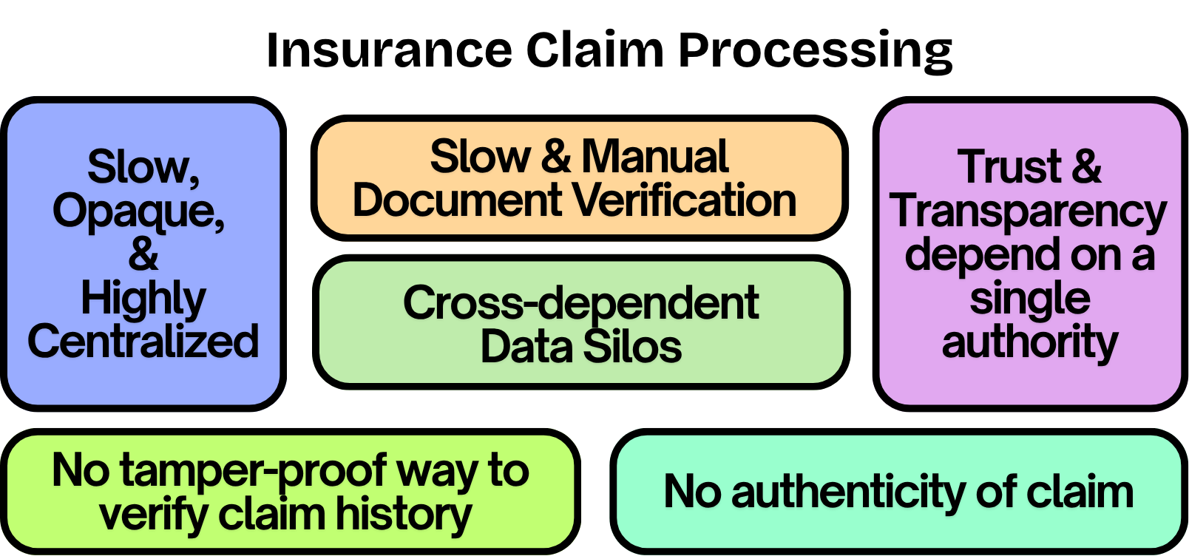
Problem Statement

Slide 4
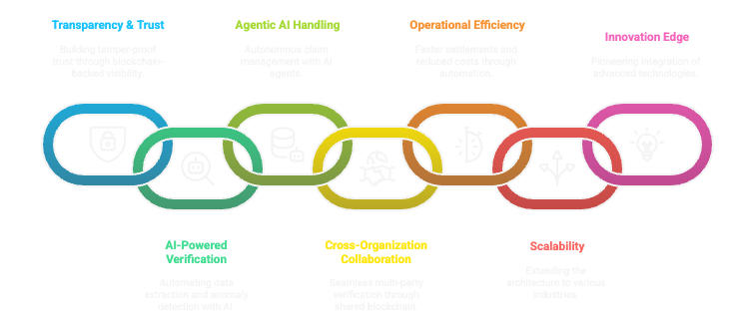
Opportunities

Slide 5
Methods / Approach
Blockchain Automation: Use blockchain to log and track each stage of the claim process—such as verification, tracking history, and status updates—ensuring transparency and reducing delays and manual work.
AI-Powered Document Analysis : Use AI models to extract, validate, and compare claim documents against policies and fraud data for faster, accurate processing.
Decentralized Verification Network : Enable consensus-based claim validation among insurers, third parties, and regulators for transparent, tamper-proof verification.
Immutable Audit Trail : Record all claim actions on a distributed ledger to ensure transparency, traceability, and regulatory compliance.

Slide 6
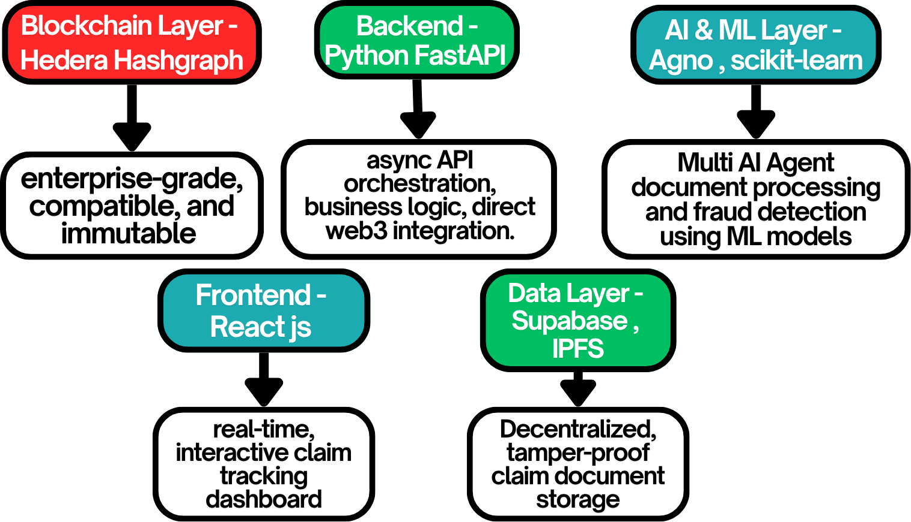
Technology Stack

Slide 7
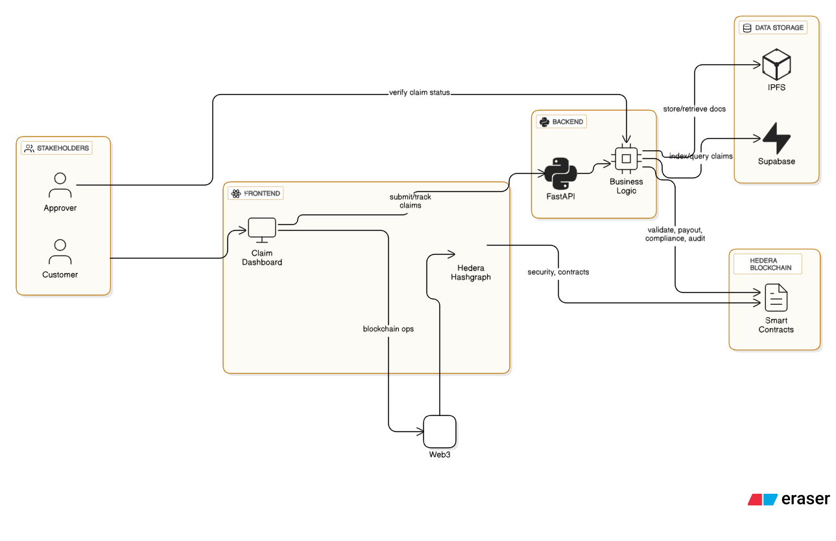
Architecture Diagram
Can be extended to multiple slides if necessary

Slide 8
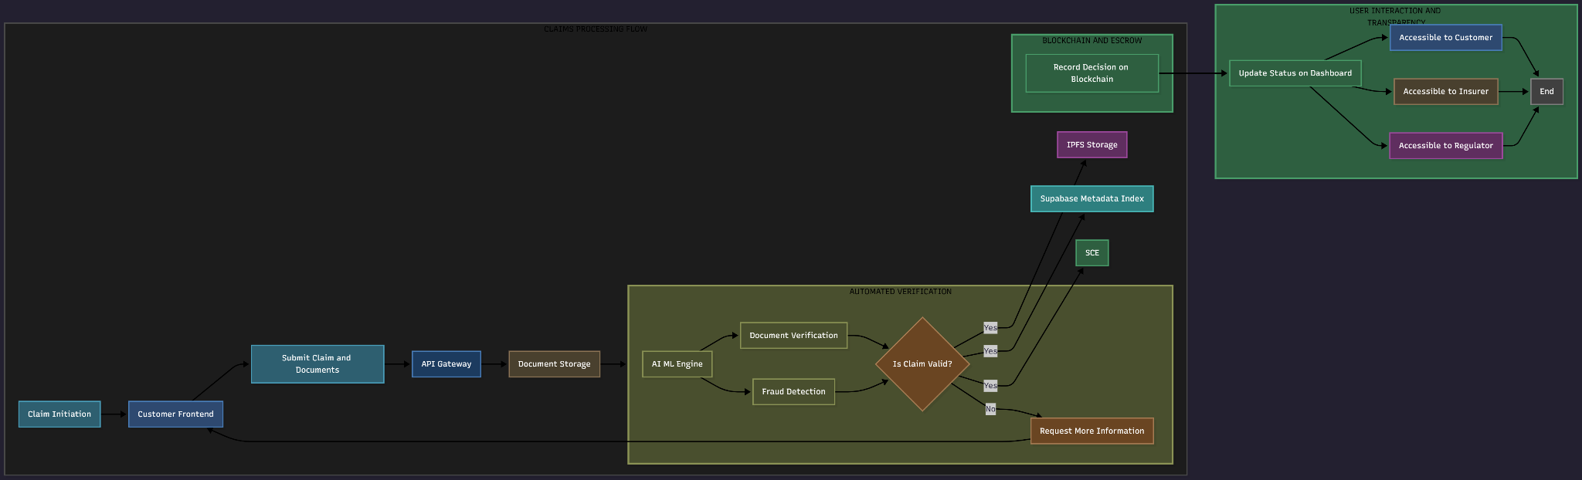
Process Flow Diagram
Can be extended to multiple slides if necessary

Slide 9
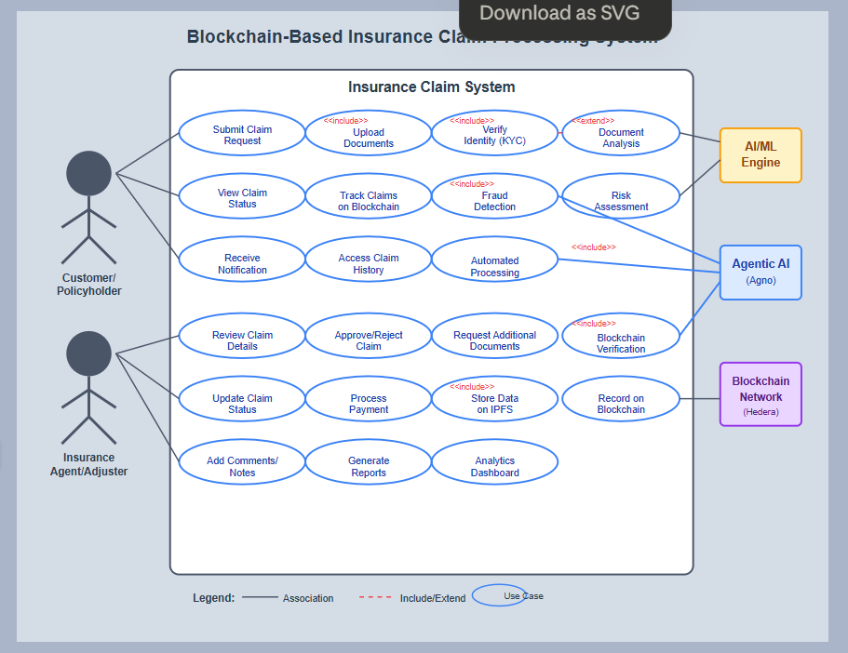
Use Case Diagram
Can be extended to multiple slides if necessary

Slide 10


